Slide 1

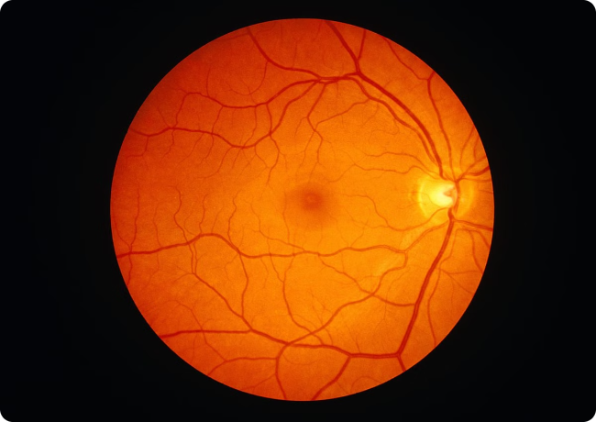
Multi-Label
Retinal Disease Classification
Accurately diagnosing and classifying retinal diseases is crucial in ophthalmology. This presentation explores a transformer-based architecture for multi-label retinal disease classification using the MuReD dataset.
Presented By :
1. Abdul Hadi Zeeshan
(22AIB462)
2. Syed Mohd Tashif
(22AIB415)
Supervised By :
1. Prof. Rashid Ali
2. Waqarul Hasan

Slide 2
Index
Problem statement : Why we need Retinal Disease Classification​
The MuRed Dataset
Related Work
​Model Architecture
Multi-Scale Fusion Module
Conclusion
References
​

Slide 3
Problem Statement: Why We Need Retinal Disease Classification
1
Retinal diseases affect millions of people worldwide
2
Manual diagnosis by ophthalmologists is time-consuming
3
There is a need for an automated retinal disease classification system
4
This will enable early detection, timely intervention, and improved patient outcomes.

Slide 4
Related Work
Zhou, Wei, et al.[1] "Aligning image semantics and label concepts for image multi-label classification." ACM Transactions on Multimedia Computing, Communications and Applications 19.2 (2023): 1-23.
The feature extraction module exploits CNN to extract image features. The residual encoder module learns image salient semantic features. The self-attention layers in the aligned decoder capture the correlation between labels, and the cross-attention layers in the aligned decoder align the image semantic features and label concepts. The last layer output of encoder and decoder are fused to obtain the final output feature.
The ISLC model outperforms the current state-of-the-art methods, and it achieves the best performance of 0.91 ML AUC .

Slide 5
Rodríguez, Manuel Alejandro, Hasan AlMarzouqi, and Panos Liatsis.[2] "Multi-label retinal disease classification using transformers." IEEE Journal of Biomedical and Health Informatics (2022).
C-Trans architecture. A feature extractor is used to generate the set of feature embeddings. Then, the label embeddings are combined with the state embeddings to train the model using partial information. Finally, the output from the transformer is used to feed the MLP head to output the probabilities for the unknown classes.
It was observed that the model had a good performance overall, with most of the AUC scores per class being above 90%.
The C TRANS model outperforms the current state-of-the-art methods, and it achieves the best performance of 0.96 ML AUC .

Slide 6
The MuReD Dataset
Dataset Composition
The MuReD (Multi-label Retinal Disease) dataset is a large-scale, diverse collection of retinal fundus images annotated with multiple labels, reflecting the real-world complexity of retinal disease diagnosis.
The dataset contains over 2,500 images, covering a wide range of pathologies.
Annotation Schema
Each image in the MuReD dataset is annotated with a set of binary labels, indicating the presence or absence of various retinal diseases.
This multi-label approach allows for the study of co-occurring pathologies, which is crucial for understanding the intricate relationships between different retinal conditions.

Slide 7
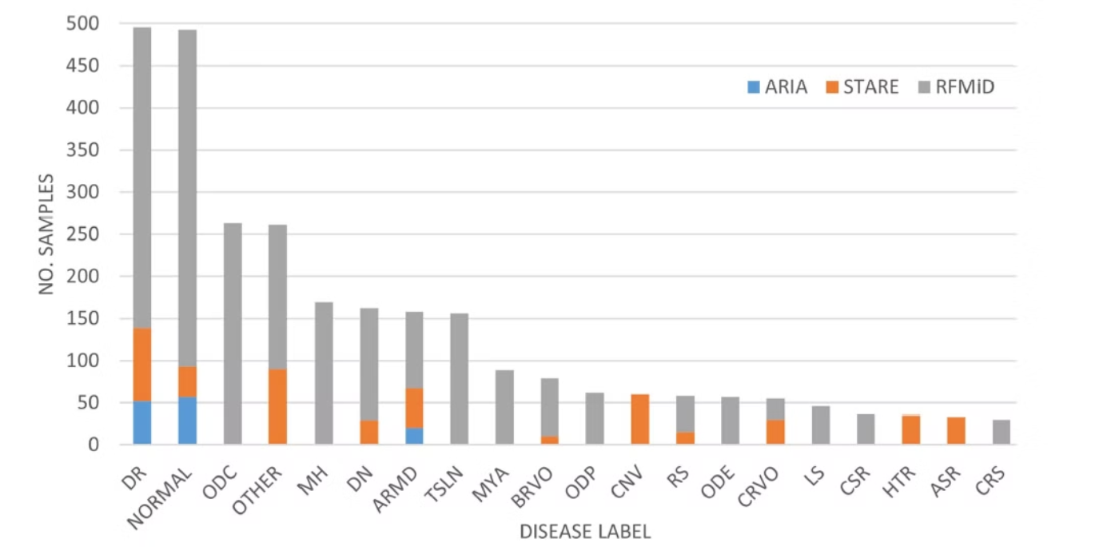
Labels:
DIABETIC RETINOPATHY
NORMAL
MEDIA HAZE
COLOBOMA
OPTIC DISC
TESSELATION
AGE TELATED MACULAR DEGENERATION
DRUSEN
MUOPIA
BRANCH RETINAL VEIN OCCLUSION
OPTIC DISC PALLOR
CENTRAL RETINAL VEIN OCCLUSION
CHORIODAL NEOVASCULARIZATION
RETINITIS
OPTIC DISC EDEMA
LASER SCARS
CENTRAL SEROUS RETINOPATHY
HYPERTENSIVE RETINOPATHY
ARTIFICIAL SILICON RETINA
CHORIORETINITIS
OTHER
Distribution of Disease Label in the MuRed Dataset:

Slide 8
Model Architecture
The feature extraction module utilizes a Convolutional Neural Network (CNN) to derive visual features from input images.
These features are then passed through a Multi-Scale Fusion Module (MSFM) that aligns high-level and low-level features.
This module combines features from different scales to capture a more comprehensive representation of the images.
From the trained BioBert model, the semantic label vector is obtained.
These label vector are concatenated with refined features from MSFM are given as input to encoder where they are processed using self-attention mechanisms. This approach enables the model to understand and leverage complex relationships between images and labels within the data enhancing the overall performance and accuracy.

Slide 9
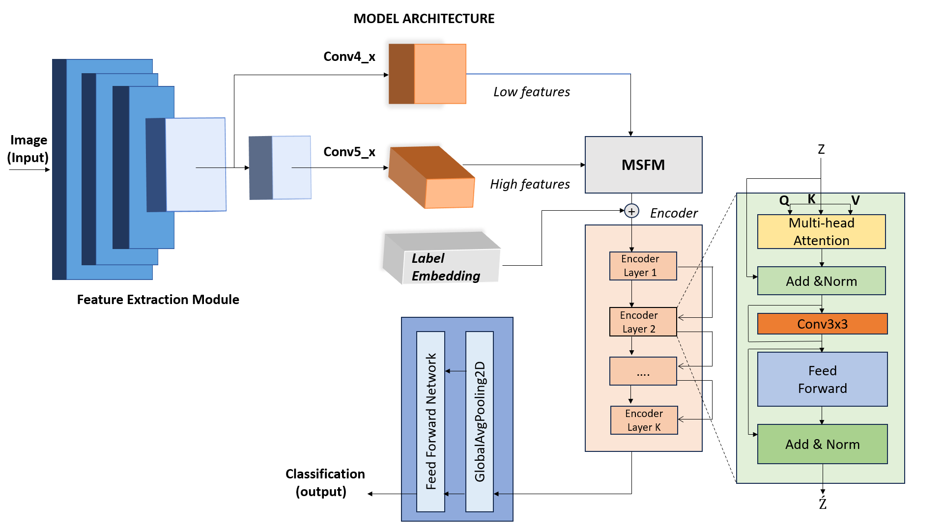

Slide 10
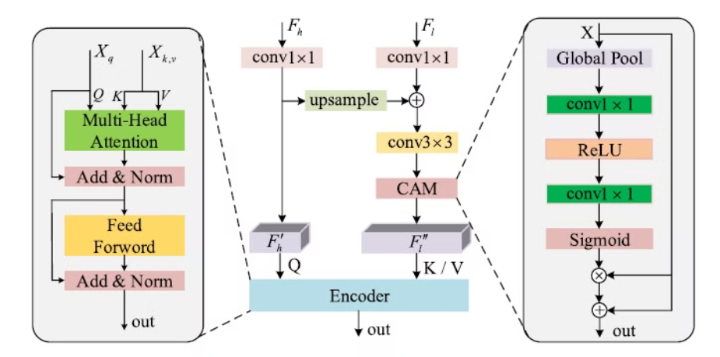
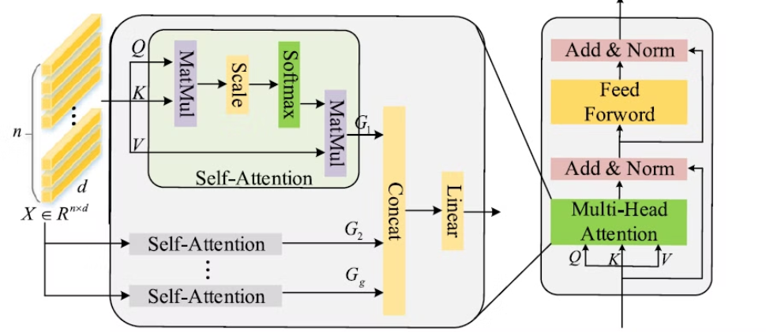
MULTI – SCALE FUSION MODULE
MULTI HEAD ATTENTION

Slide 11
MULTI SCALE FUSION MODULE
Base Model: The architecture uses E as the base model for high-level features, pretrained on ImageNet.
Feature Extraction: High-level features are extracted from the final layers of the base model, while lower-level features are extracted from an intermediate layer (block6h_add).
Multi-Scale Feature Merging :
The high-level and lower-level features are transformed using 1x1
convolution layers.
The transformed features are fused together using an addition operation, followed by a 3x3 convolutional layer.
Class Activation Mapping (CAM): Features go through global average pooling, 1x1 convolutional layers, and element-wise multiplication with the merged features.
Multi-Head Attention: A Multi-Head Attention layer with 8 heads and a key dimension of
512 processes the features.
Feed Forward Network: The attention output is passed through a feed-forward network with a fully connected dimension of 512.
Final Output: The output from the MSFM module is reshaped and processed as the final output of the architecture.

Slide 12
CONCLUSION
The Transformer-based approach outperformed traditional CNN-based methods on the MuReD dataset, showcasing the superior performance attributed to its self-attention mechanism.
The Transformer architecture's attention visualization capabilities offer valuable insights into the model's decision-making process, aiding model in understanding the specific features and patterns guiding its predictions.
Our Transformer-based Model is able to effectively learn rich dependencies between labels and features and able to achieve 0.927 ML_AUC on the MuRed Dataset

Slide 13
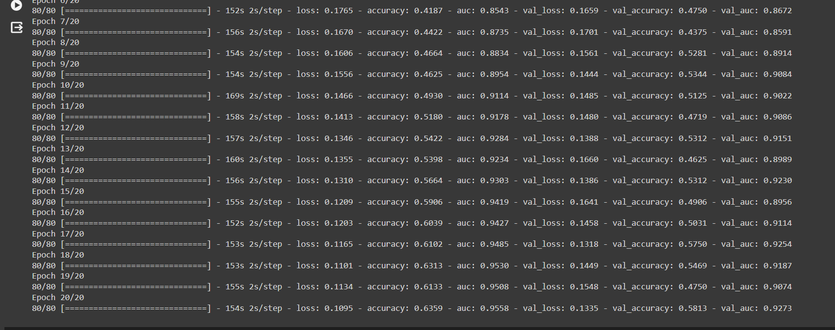

Slide 14
References
Zhou, Wei, et al. "Aligning image semantics and label concepts for image multi-label classification." ACM Transactions on Multimedia Computing, Communications and Applications 19.2 (2023): 1-23.
Rodríguez, Manuel Alejandro, Hasan AlMarzouqi, and Panos Liatsis. "Multi-label retinal disease classification using transformers." IEEE Journal of Biomedical and Health Informatics (2022).

Slide 15
THANK YOU

